Slide 1
Java

Slide 2

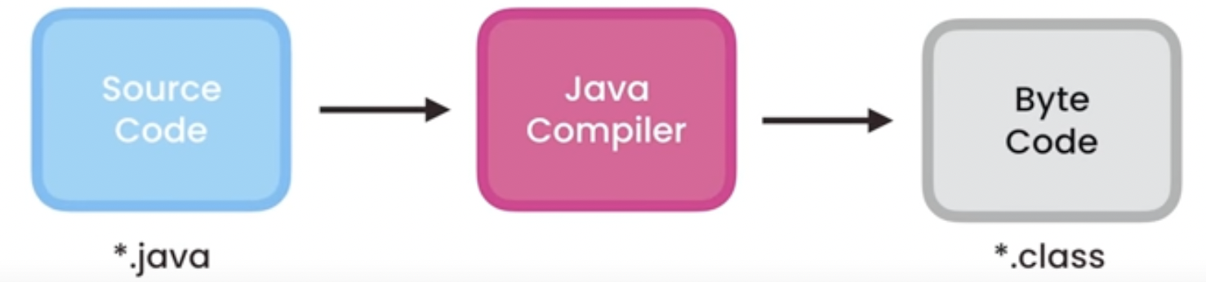
Java Code Execution
Whenever a program is created, its should be compiled and then executed.
In the compilation,

Slide 3
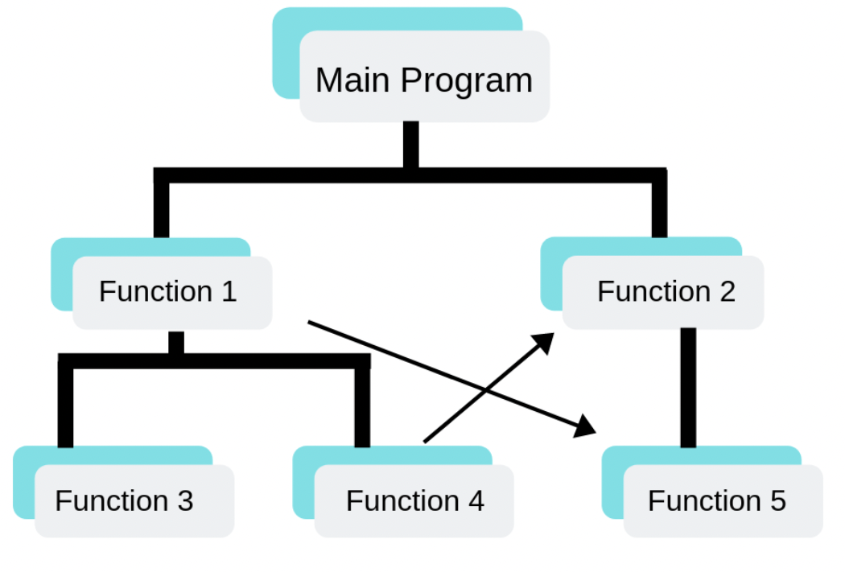
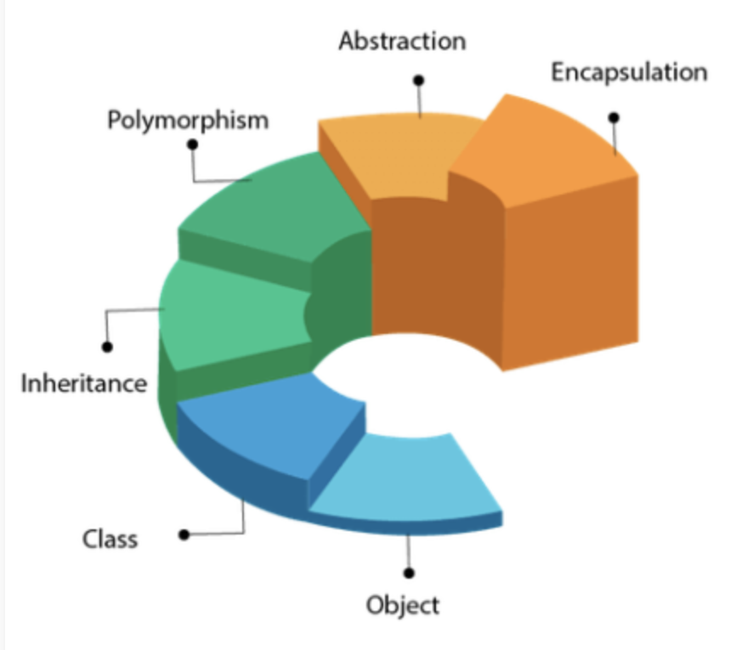
Unstructured – Structured - OOPS
UnStructured Programming
Structured Programming
Object Oriented Programming
Eg, BASIC, Fortran, COBOL.. etc
Eg, C, C++, PHP, Ruby.. etc
Eg, C++, C#, Java, Python..
10 Input A
15 Input B
20 B=A+10
30 IFB>12 GOTO 60
40 C =B/3
50 IF C < 24 GOTO 10
60 Write C
70 IF Write Failed GOTO 15
80 INPUT D

Slide 4
OOP – Object Oriented Programming
What is an OOP?
It is method of programming where code is designed based on the functions and attributes of the objects.
Class Student{
int studentId;
String studentName;
String studentClass;
public String getStudentName(){
return studentName;
}
}

Slide 5
OOP’s Concepts
object
class
abstraction
encapsulation
inheritance
polymorphism

Slide 6

Objects - Java
It’s a real world entity, whatever we see can be called as an object which have attributes and methods.
Eg. car is an object, which have attribute such as weight, color and methods like drive and break.

Slide 7

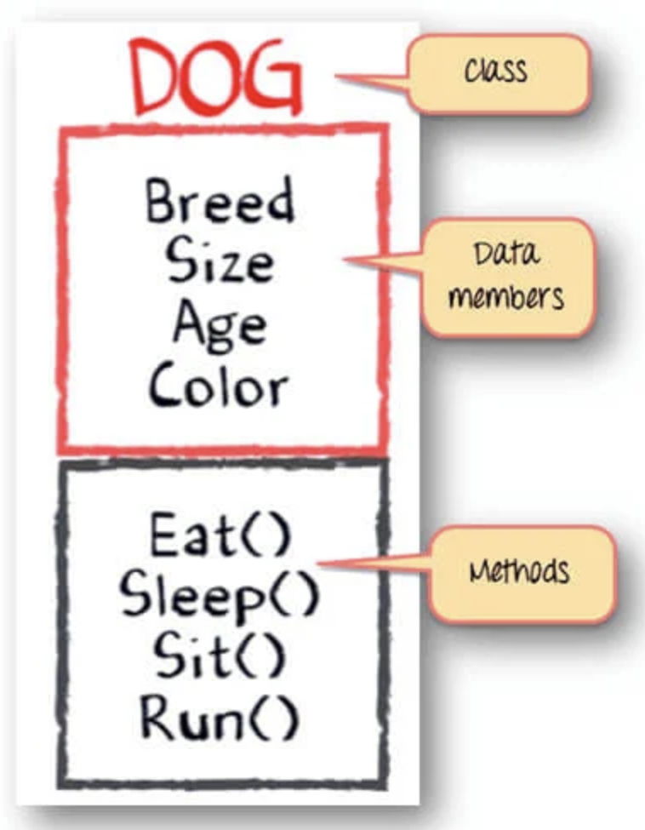
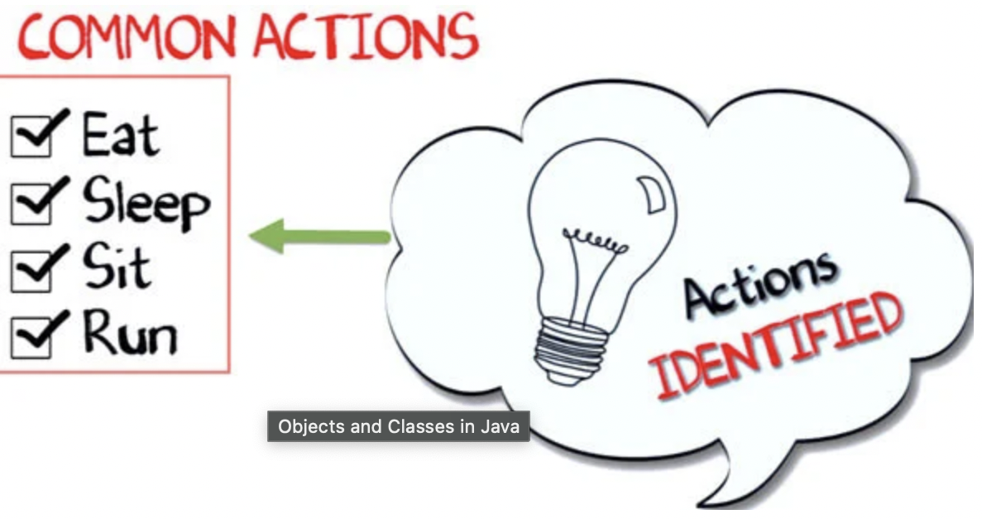
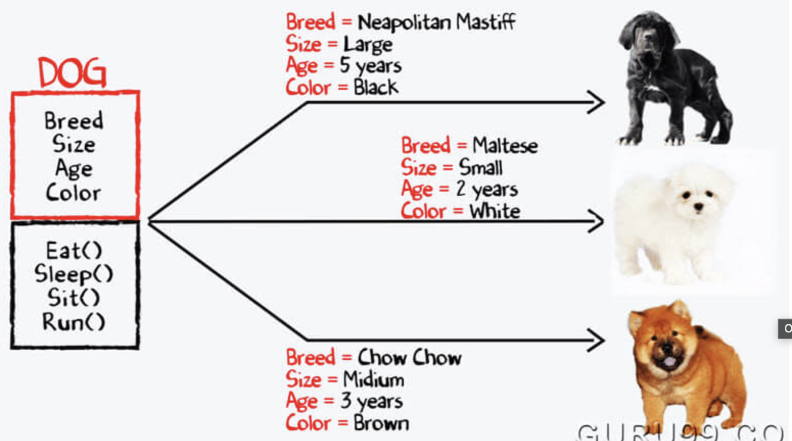


Class - Java
Is a blue print or a prototype from which objects are created.
Eg. Dog,

Slide 8
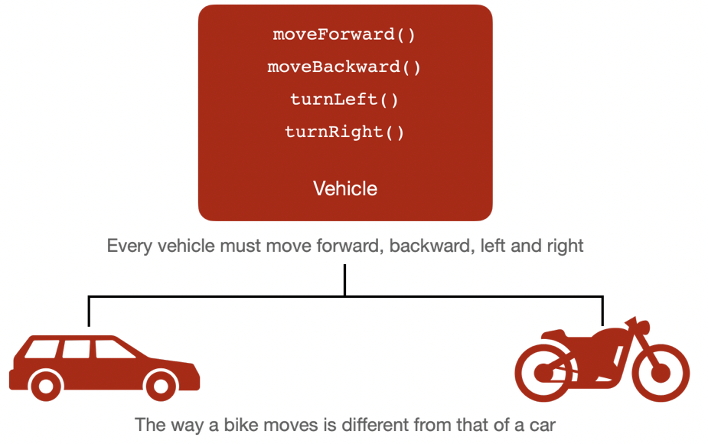
Abstraction - Java
Abstraction is a process of hiding the implementation details and showing only functionality to users.
Abstract class
Interface

Slide 9
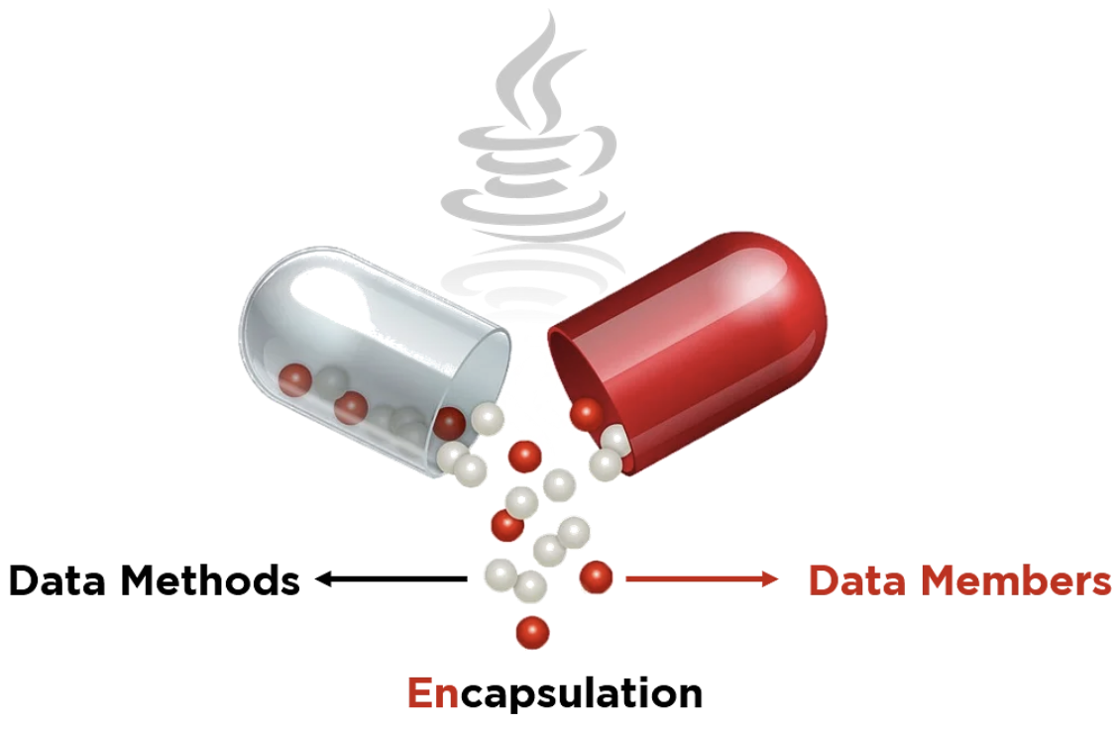
Encapsulation - Java
Encapsulation is like a capsule. The whole code and data is bounded together into a single unit.
As we can see the members and methods are
defined inside one class like a capsule.
Use of encapsulation,
Better control of class attributes and methods.
Class attribute can make ready/write only.
Is used to protect the data, and the variables must be private and can only be accessed through the methods.
Its mainly for the security purpose for the variables.

Slide 10
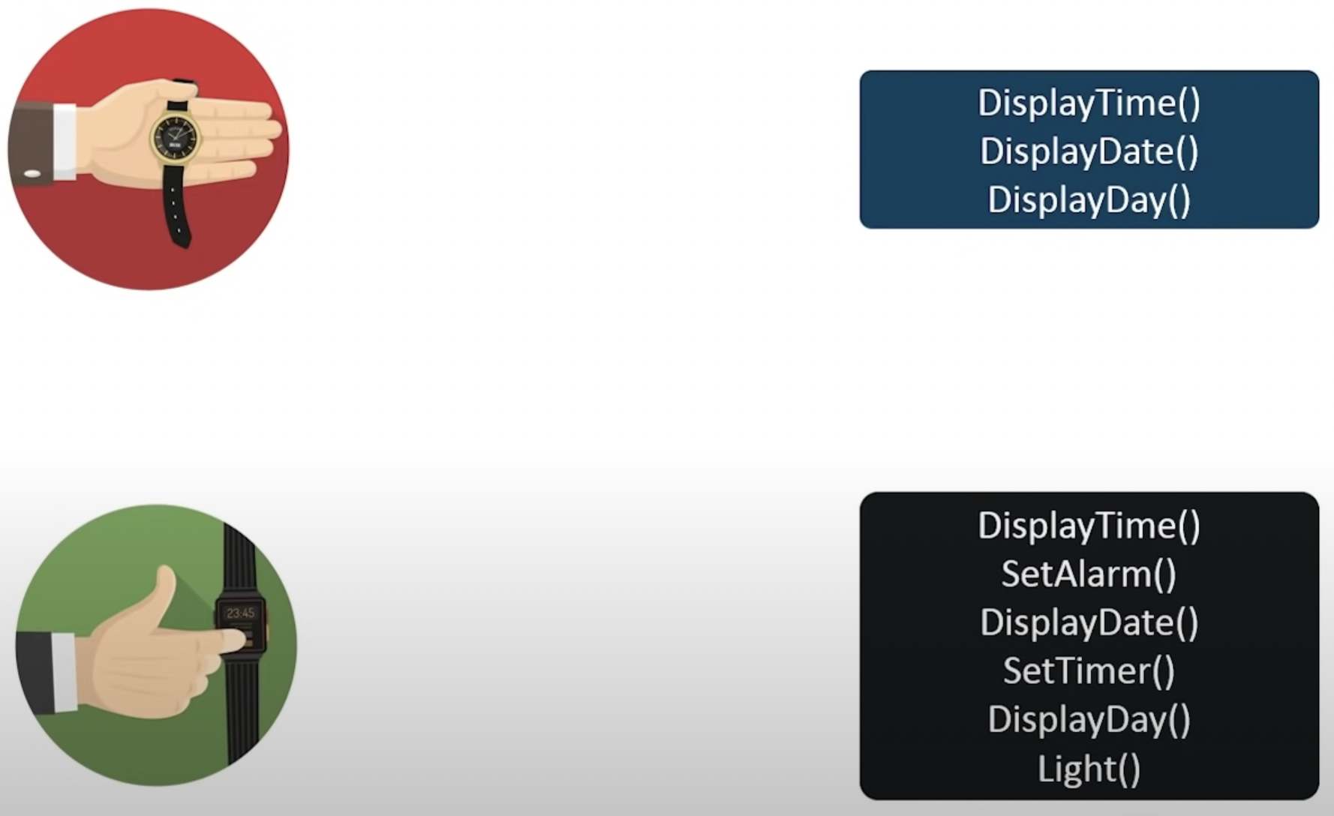
Inheritance - Java
Java Inheritance is a procedure in which, the subclass inherits all the properties and behaviors of super class.
In order to reduce the code redundancy.
Eg. If we have 2 classes with same
method name, can reduced by using
the inheritance.
Redundant code is nothing but the same source/compile code in the program which is
Unnecessary, such as computing the value which is priorly calculated.

Slide 11
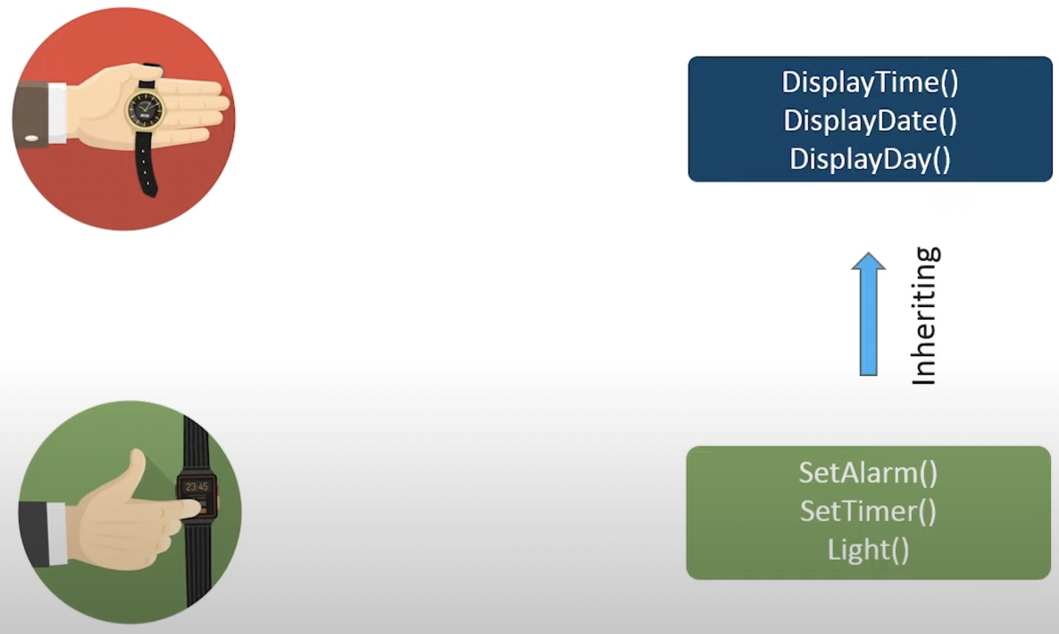
Inheritance - Eg

Slide 12
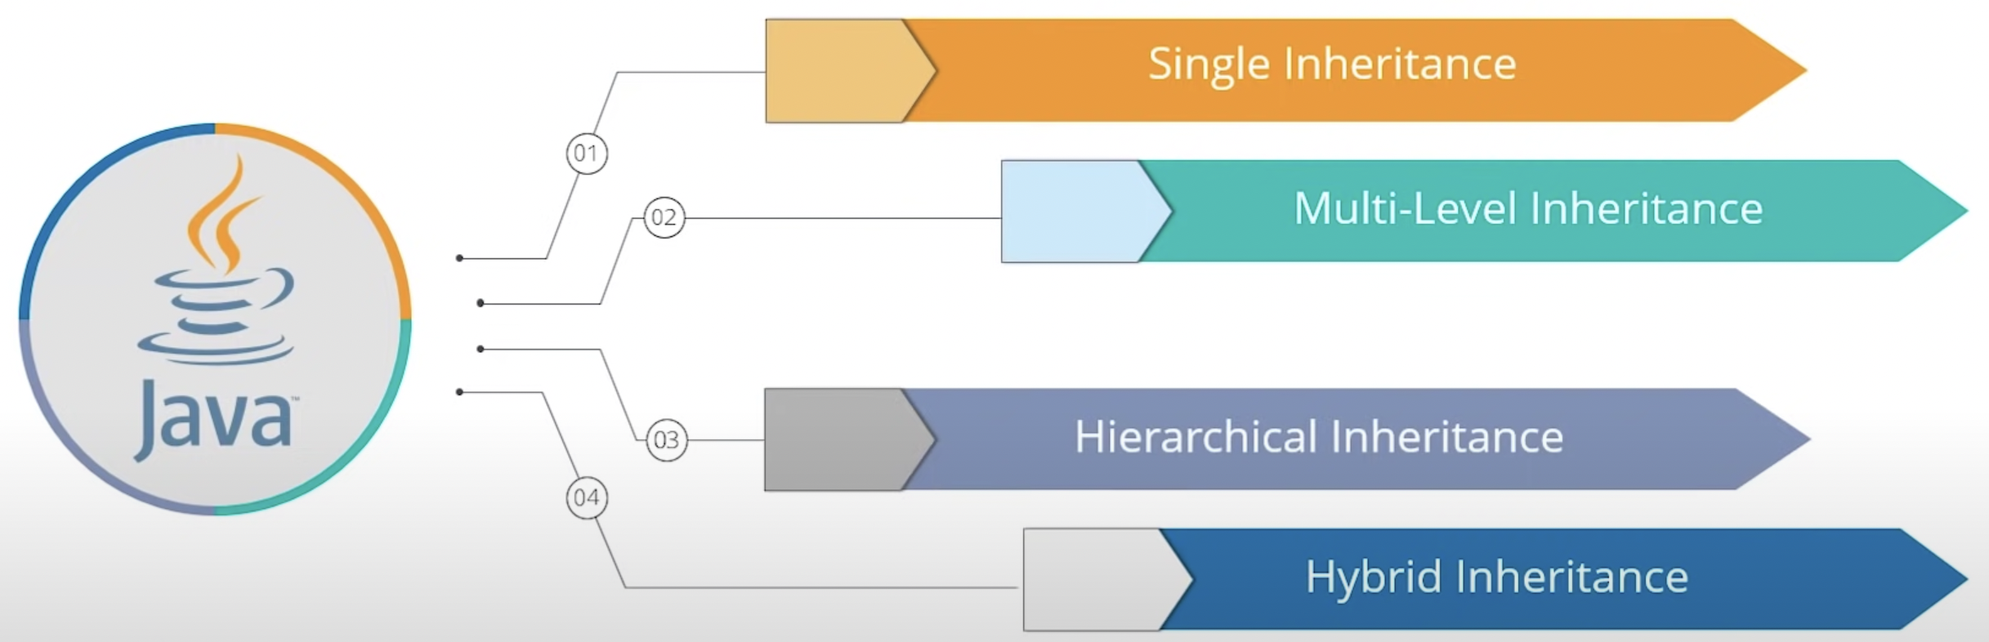
Types of Inheritance
Single, Multilevel, Hierarchical, Hybrid

Slide 13
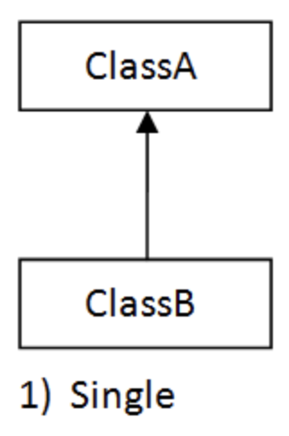
Single - Inheritance
In Java, single inheritance is a process where subclass inherits all the properties and behaviors of a single superclass.

Slide 14
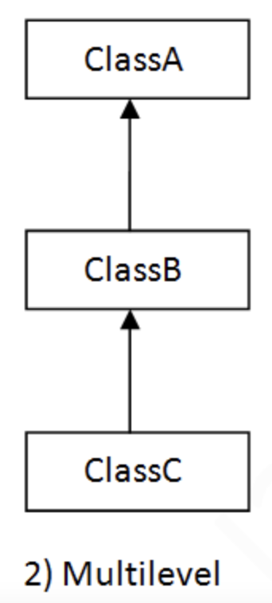
Multilevel - Inheritance
In Java multilevel inheritance is the process where subclass inherits all the properties and behaviors of more than one super class at multiple levels.

Slide 15
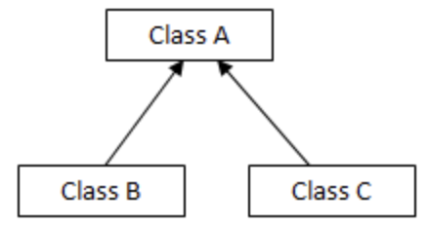
Hierarchical - Inheritance
In Java hierarchical inheritance is a process where one ore more subclass inherits the properties and behaviors of the superclass.
Eg: Class A is warehouse which have all vegetables/
properties like tomato, onion, potato, rice
and methods like readyMadeSoup(),
readyMadeSaus().
Subclass B/C are the restaurants that
inheritance properties and method from
superclass A.

Slide 16
Hybrid - Inheritance
Hybrid Inheritance is the combination of one or more inheritances.
We can see multilevel and hierarchical
inheritance.
Class A
Class B
Class C
Class D
Class E

Slide 17
Overloading - Java
Method overloading is a feature that allows a class to have more than one method having the same name, if the arguments list are different.
Three types of method overloading.
Number of parameters.
Datatype of the parameters.
Sequence of the datatype of the parameters.

Slide 18
Overriding - Java
Method overriding is a features that allows the parent and the subclass can have the same method name.
Rules,
The argument list of the child class should match with parent class.
Must have same name and same signatures.
Return type must be same or covariant.
It’s a run time polymorphism.

Slide 19
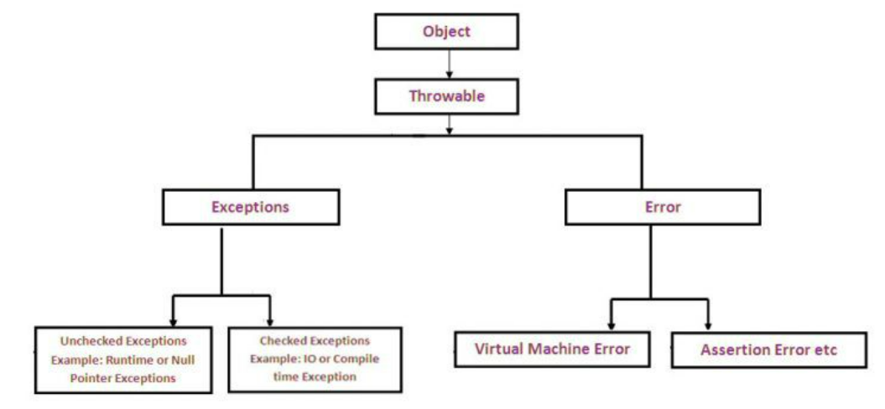
Hierarchy Exception - Java
Throwable is the top of the exception hierarchy
following which are the subclass-Error
and Exceptions.
Exceptions and Error are
two different classes.
Error can be handle in the program.
Exceptions can be handled in the
program.

Slide 20
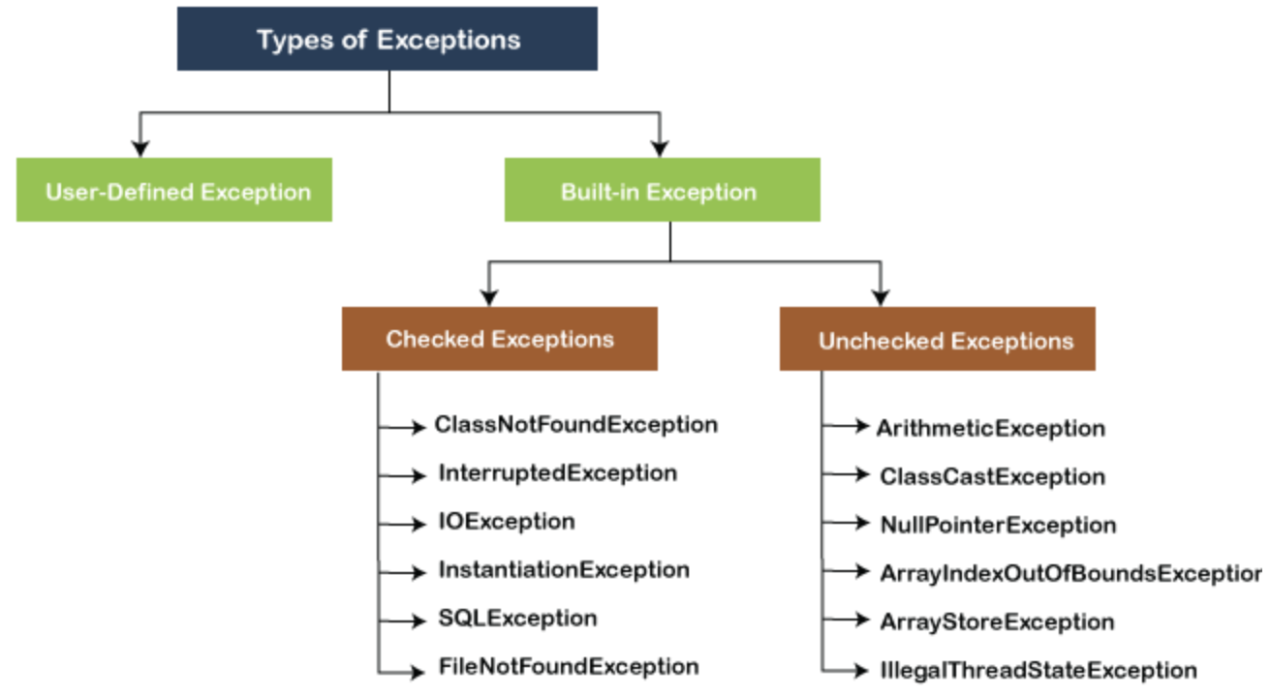
Exception Handling - Java
Exception is an unwanted event, which occur during the execution of the program.
Exceptions can be categorized
into two ways,
User-Defined Exception
Built-in Exception
Throwable
Exception
IOException
File Not found Exception

Slide 21
Build in Exceptions
Exceptions that are already available in java libraries are referred as build in exceptions.
These exceptions are able to define the error situations, so that we can able to understand reason for getting the error.
It has been categorized into two,
Checked Exceptions
Unchecked Exception

Slide 22
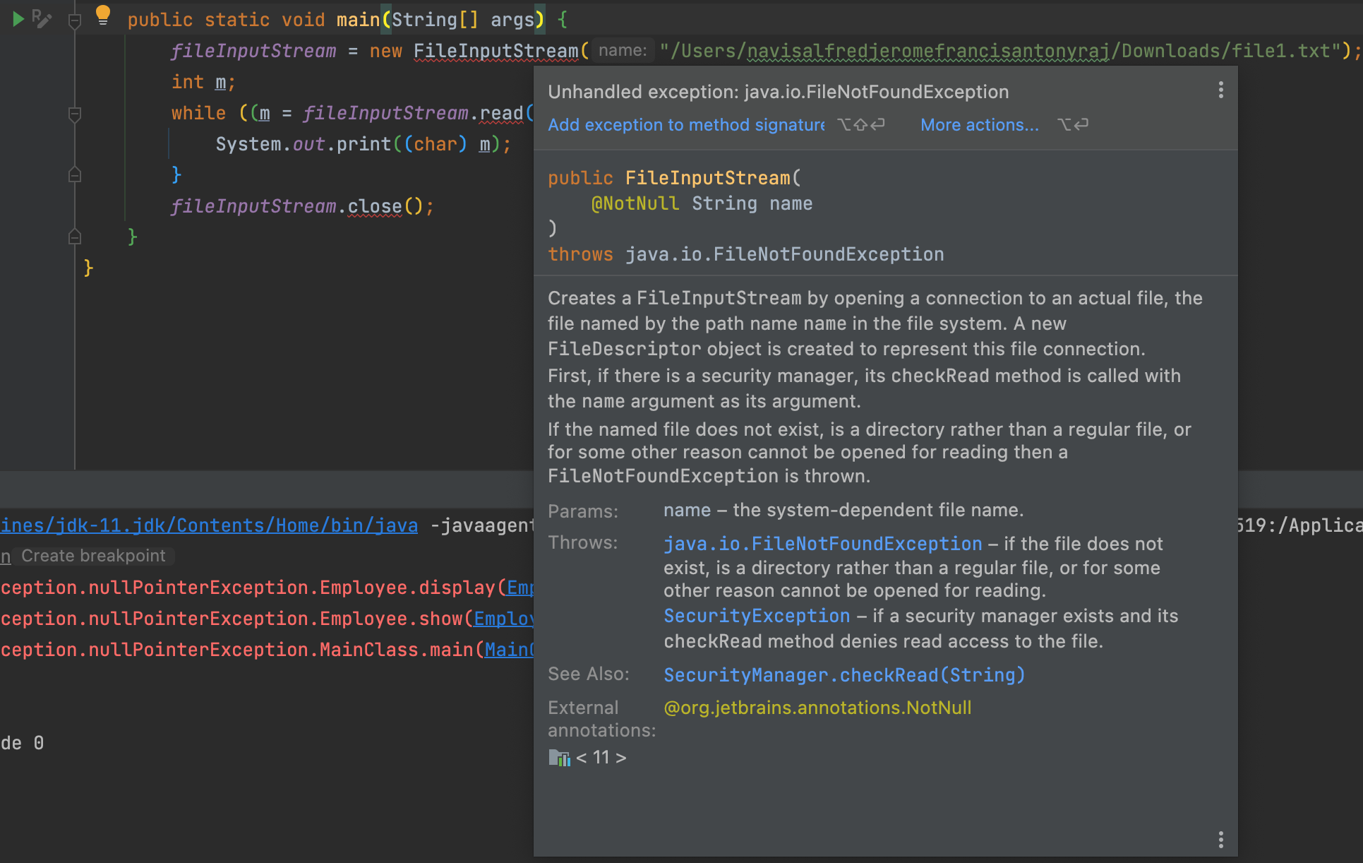
Checked Exceptions
The exceptions that checked during the compile-time.
The programmer should handle the exceptions, otherwise the system will show a compile time error.

Slide 23
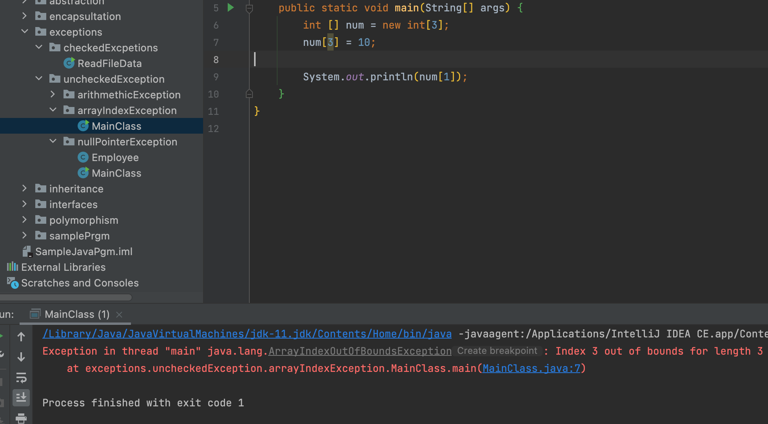
Unchecked Exceptions
Unchecked Exceptions are handle at the runtime not during the compile time.

Slide 24
Exception - Hierarches
.
Throwable
checked
Exception
Error
unchecked
Runtime Exception

Slide 25
User Defined Exceptions
We can create an own exceptions that are derived classes/sub classes of exception class.
Create a own exception is know as custom exception or user defined exception.
Exception
InvalidAgeException

Slide 26
Super keyword - Java
Super keyword in Java is a reference variable which is used to refer immediate parent class object.
Super can be used to refer immediate parent class instance variable.
Super can be used to invoke immediate parent class method.
Super() can be used to invoke immediate parent class constructor.
Class A String color = “blue”
Class B
String color = “black”

Slide 27
Fundamentals In Java
Types
Variables and Constants
Primitive and Reference Types
Casting
Number, String and Arrays
Read Input
Control Flow
Clean Coding
Finding and fixing errors

Slide 28
Variables in Java
It is used to store data temporally in the memory.
Eg. int age =30;
int -> Is type of the variable name “age”, we can also call as an identifier.
age -> is the variable name to store the value/data.
30 -> is the value.
What we say as “initializing the variable”, that means we are giving initial value.

Slide 29
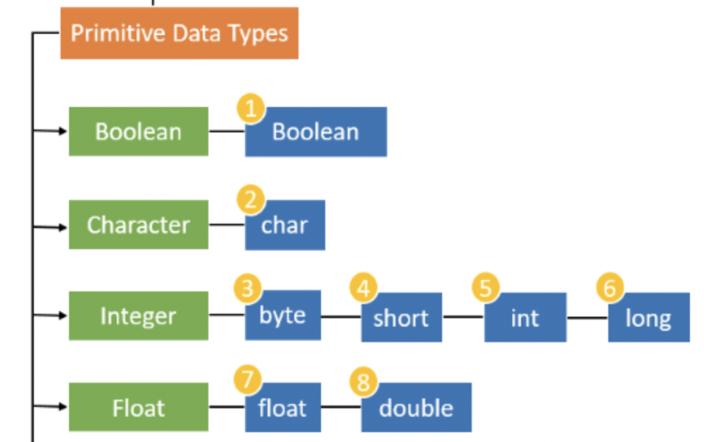
Primitive Types
It is used to store the simple values
and specify the size and type of
the variable values.

Slide 30
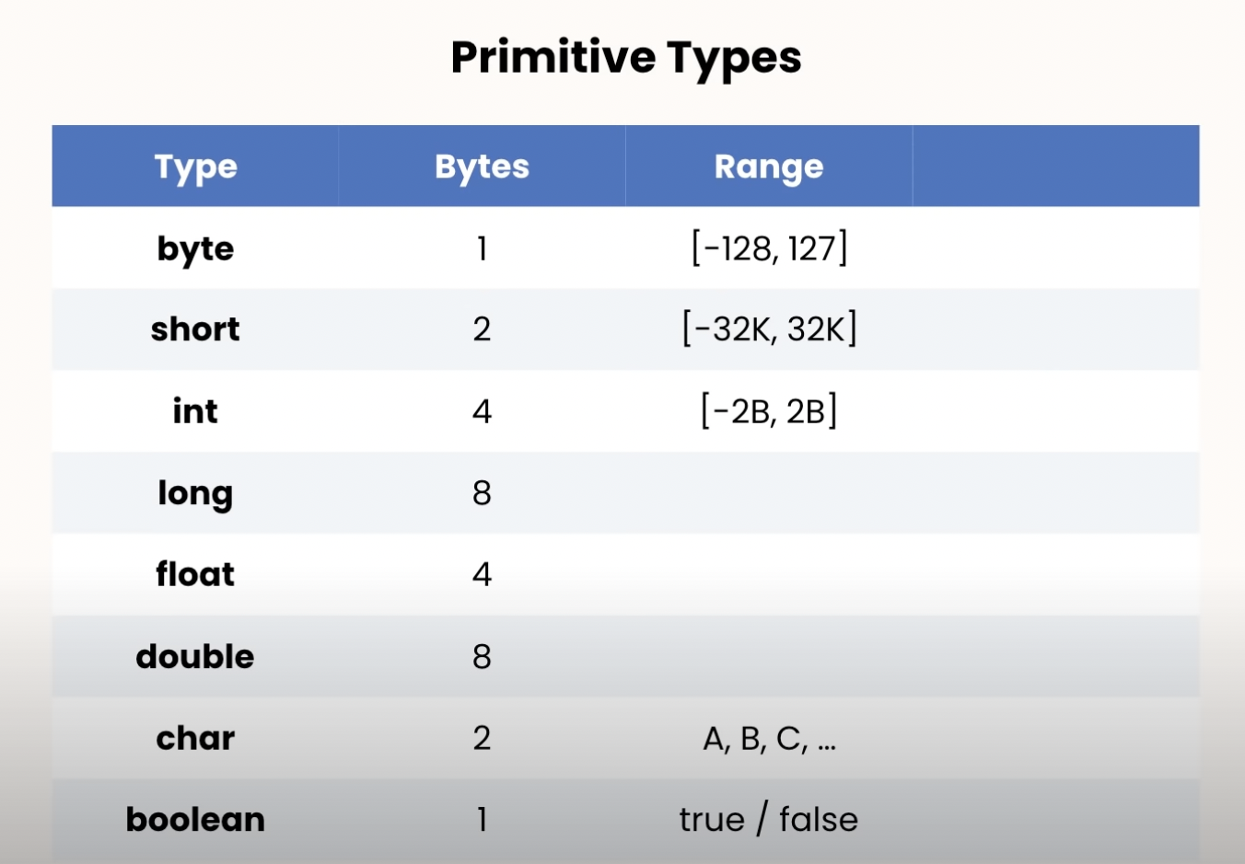
Eg:
int abc = 12345678;
int abc = 1_123_456_78;
long abc = 3_123_456_789;
float abc = 10.99F;
char letter = ‘A’;
boolean value = true;

Slide 31
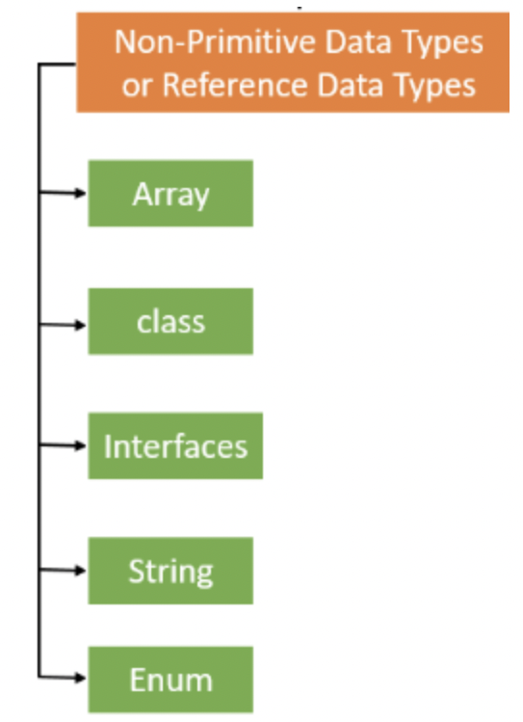
Non-primitives types or Reference Type
Non-primitive data types or reference data types
refer to instance or objects.
They cannot store the value of the variable
directly in memory.

Slide 32
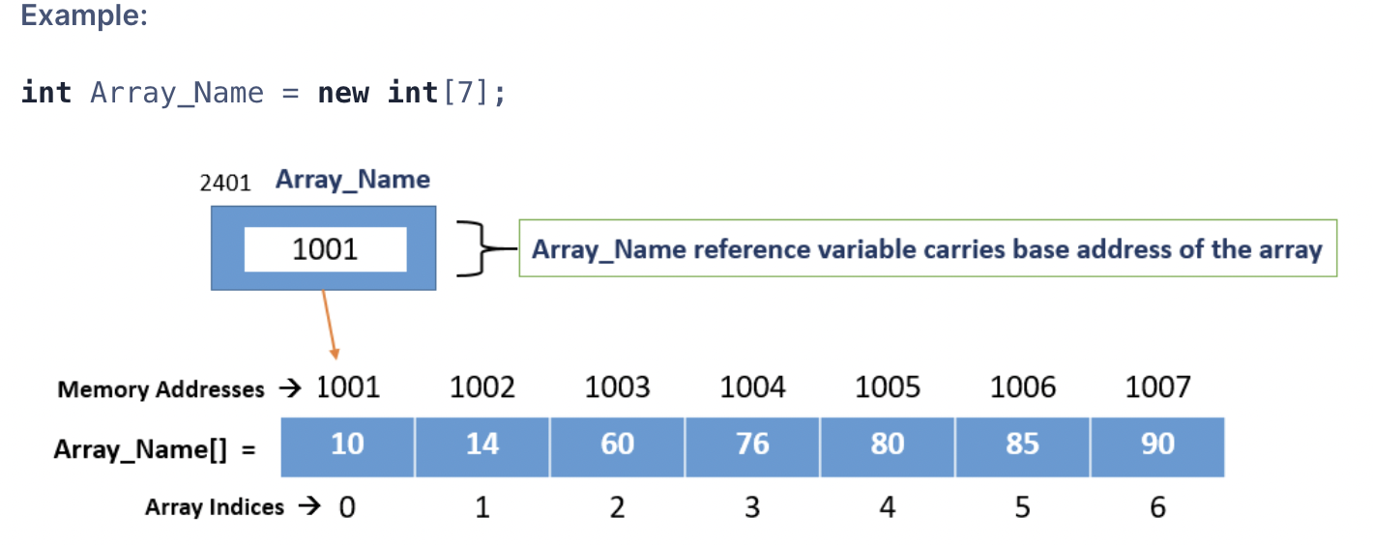
Non-primitive - Arrays
Used to hold the elements of same type. Its an object in java and the array name is the reference variable carries base address of an array.

Slide 33
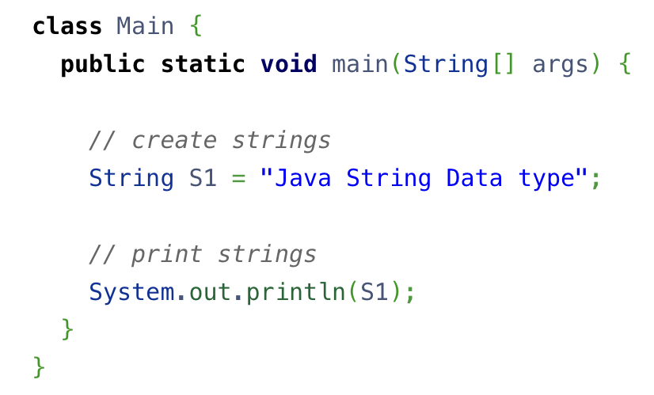
Non-primitive - String
The String data types stores sequence of data or arrays of characters.

Slide 34
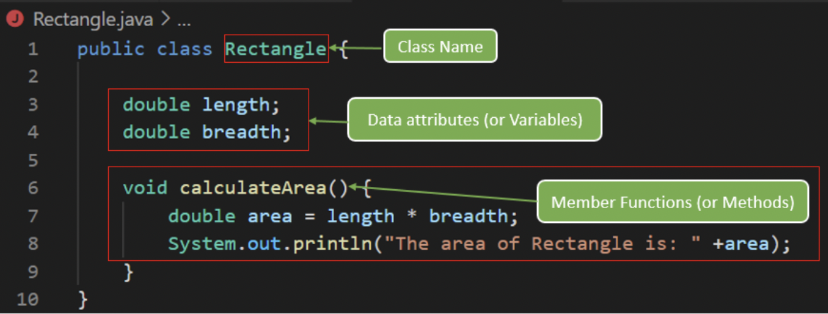
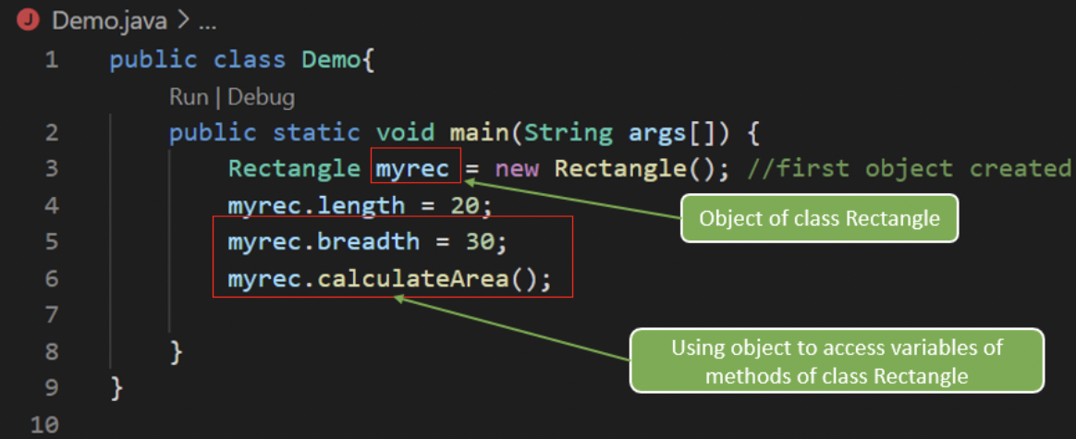
Non-primitive - Class
A class is a user defined
data type
from which objects
are created.
It contains fields and
methods
which represents the
behavior of an object.
instance of the Rectangle() class

Slide 35
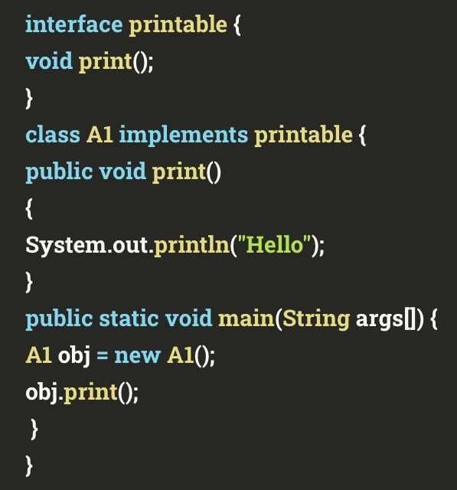
Non-primitive - interface
Interface is declared as like class. The key difference is the method declared is by default an abstract method
and they don’t have body inside.

Slide 36
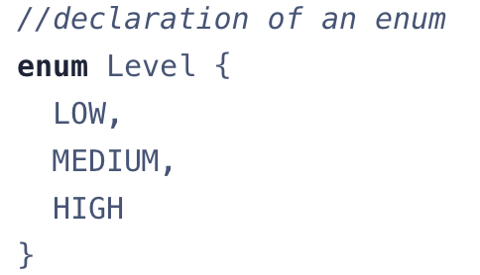
Non-primitive - enum
Enum is similar to class, in contrast to classes, enum constants are public static and final (unchangeable).

Slide 37
Class
Class is a group of objects which has common behaviors and attributes.
Class will contains one or more related methods are nothing but the behaviors.
It’s a template or a prototype for which an object are created.
Class does not occupy the memory.
Class is group of variables of different data types and methods.
Eg #1: class names are, Animal, Student, Bird, Vehicle, Company
access_modifier class <class name>{
data member;
method;
constructor;
nested class;
interface;
}

Slide 38
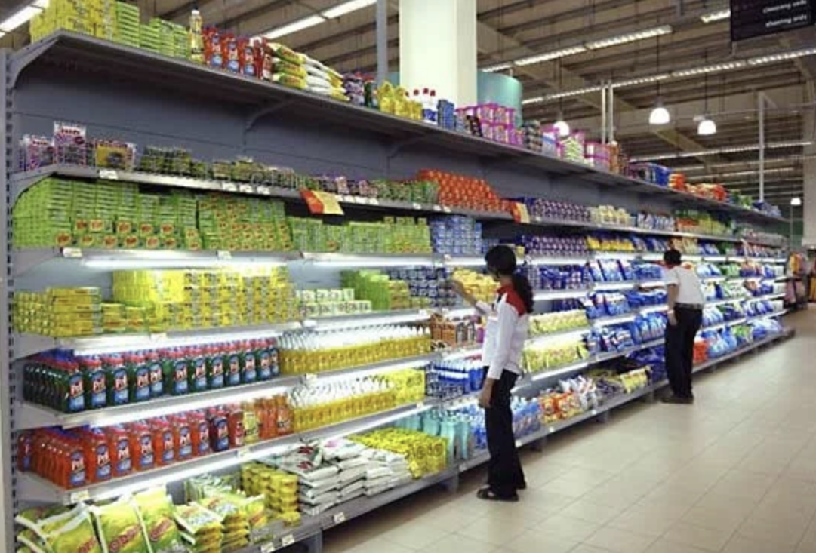
Eg #2:
In a super market we can see the sections for vegetable, fruits, meats and so on. Each contains related products, same like in Java, each class contains related methods.
Sample program,
public class Main(){
public void main(){
…
}
}

Slide 39
Access Modifiers
It is used to specifically tell the classes, methods and other members, whether it can accessed or not
Different types of access modifiers are,
public, private, protected, default.
private
If we declare as private to method or data types it can be access within the classes.
Protected
If we declare as protected to method or data types it can be accessed within the packages.

Slide 40

Functions
Function is a block of code that perform a task.
Its used perform any actions like,
Validate some Input or Output.
Function can be used to send an email.
Converting weight to kilogram.
Its like remote control you have many buttons and each perform specific actions.

Slide 41
Different Types of,
Function with return type
Function without return type
Function with return type
Syntax
returnType name(){ }
Function without return type
Syntax
void sendEmail(){}
Note:
- Void is reserve type.

Slide 42
main() function:
Every Java program should have at least one function and that function is the main().
Whenever a Java program is called inside the main() is called.
Functions can be declared only inside classes or abstract classes.

Slide 43
Constructor
Constructor in Java is special method that is used to initialized objects.
It has same name as class name.
There is no return type for constructors.
All classes have constructors, whether you define or not, Java automatically provides default constructor that initialize all the variable to zeros. However once define the default constructor the default constructor is no longer used.
Two Types of Constructors,
No argument Constructor
Parameterized Constructors
No argument Constructor
Eg: public class Demo{
int num;
Demo(){
num=100;
}
public class ConsDemo(){
public static void main(String [] args){ Demo demo = new Demo(); System.out.println(demo.num);}}

Slide 44
Java Data Types
Data types specifies the different size and values that can be stored in the variables.
Two different data types
Primitive Data Types
Non-primitive Data Types
Primitive Data Types are,
byte, short, int, long float, double, boolean and char.
Non-primitive Data Types are,
String, Arrays and Classes

Slide 45
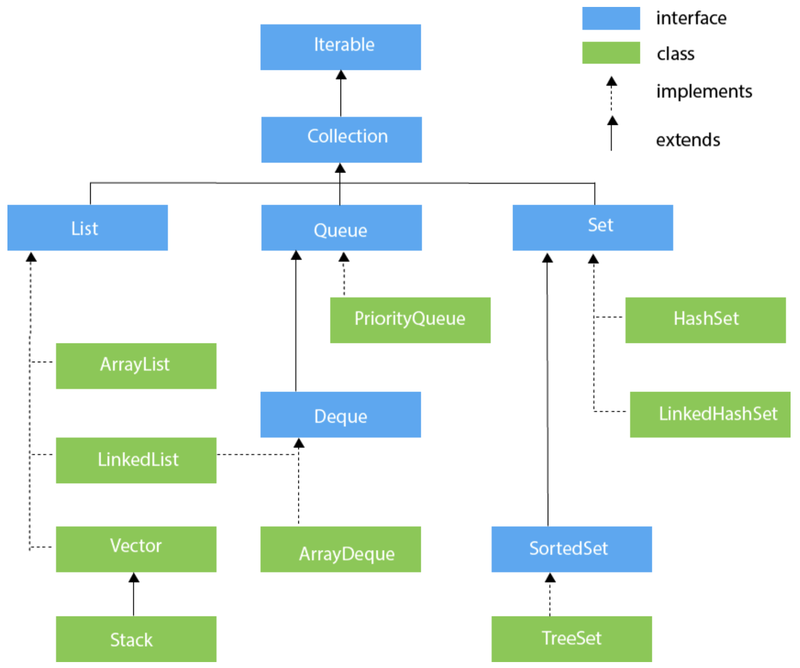
Collections - Java
Collection in Java is a framework that
provides an architecture to store and
manipulate the group of Objects.

Slide 46
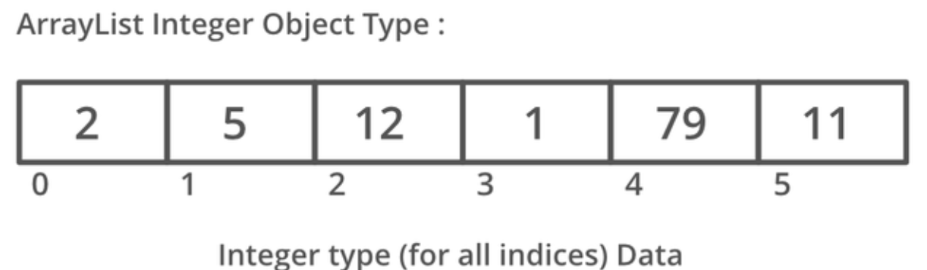
Arraylist - Java
Java Arraylist is a class, that stores the element/data dynamically.
There is no size limit, we can add or remove elements anytime.
It can have duplicate elements also.
It allows random access, because arrays works on index basis.
Using arraylist manipulation will be slower compare the LinkedList.

Slide 47
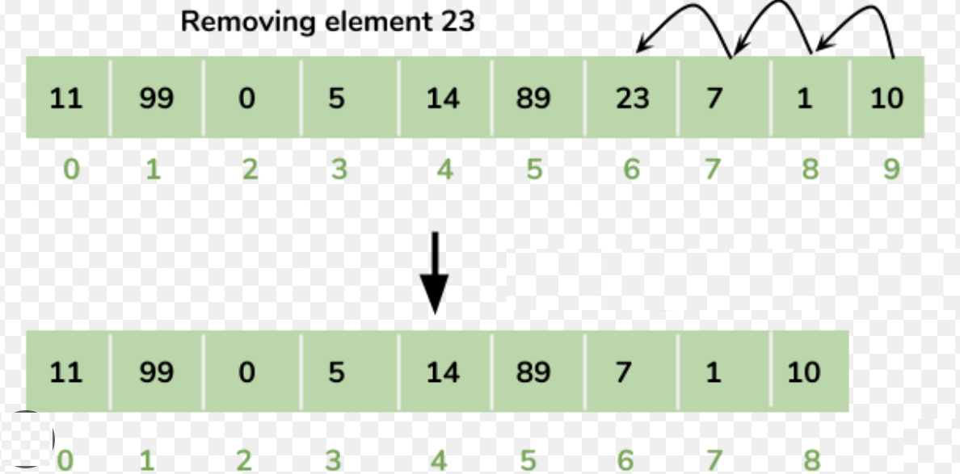
Arraylist - Manipulation

Slide 48
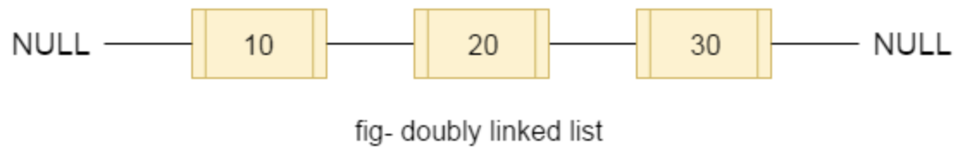
Linkedlist - Java
Java linked list class uses a doubly linked list to store the elements.
Java linked list class can have duplicate data.
It maintains the insertion order.
It non-synchronized.
Manipulation is fast because no shifting needs to occur.

Slide 49
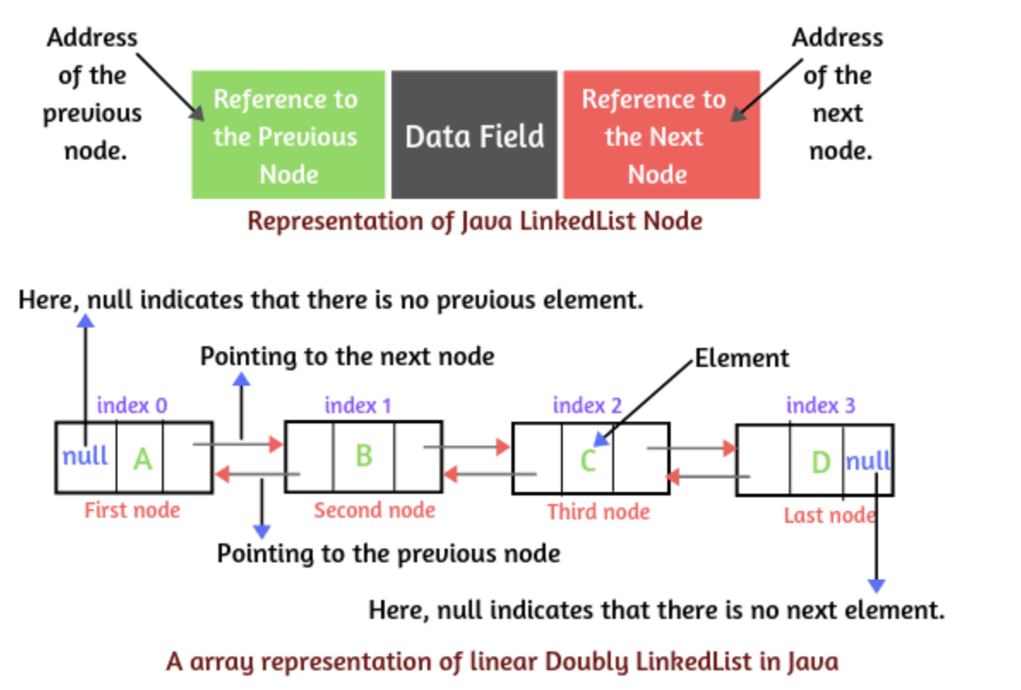
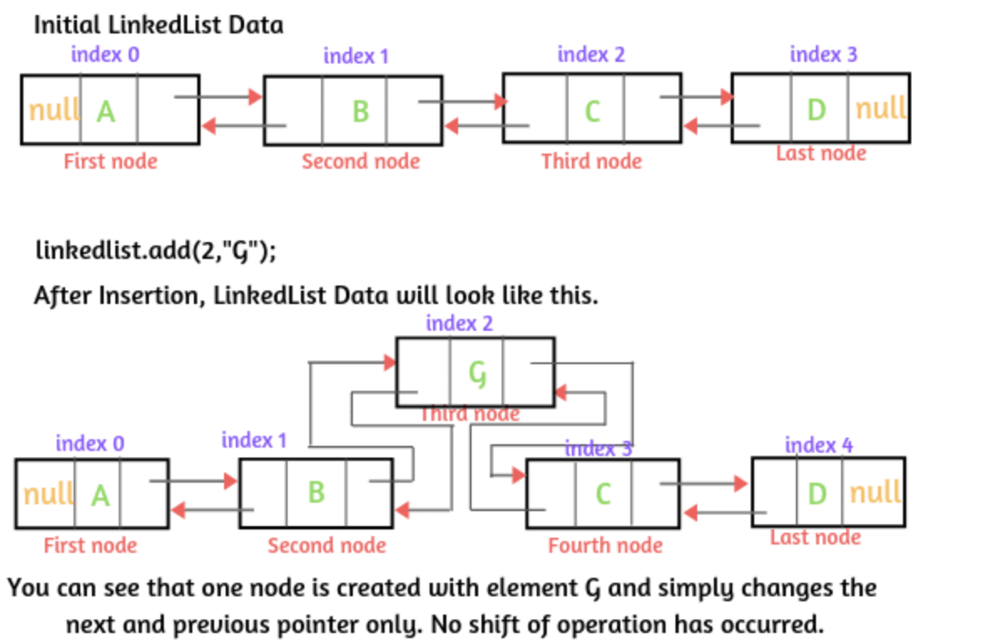
Linked list - manipulation

Slide 50
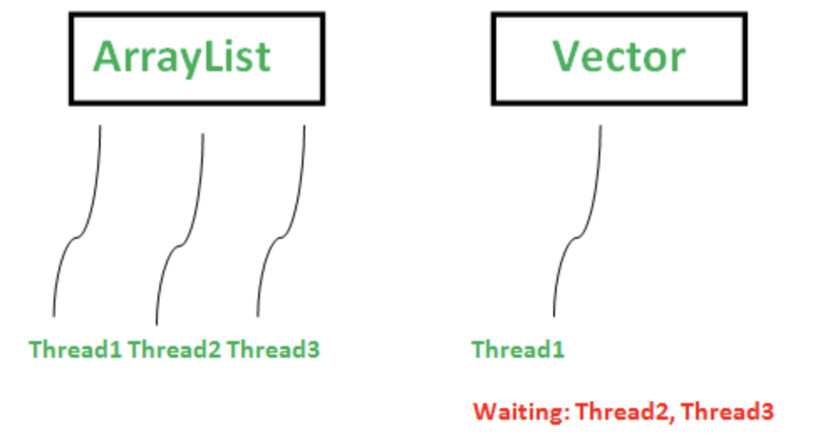
Vector - Java
Vector is like the dynamic array which
can grow or shrink its size.
Unlike array, we can store n-number of
elements in it as there is no size limit

Slide 51
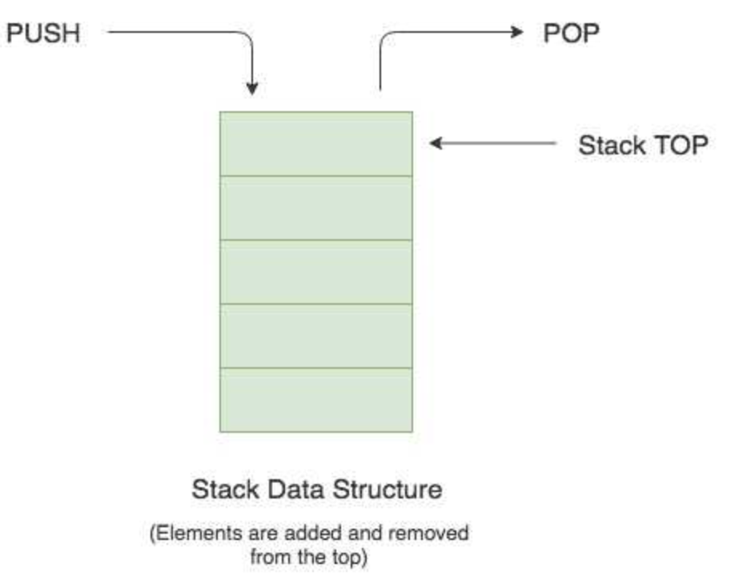
Stack - Java
Stack is the linear data structure that is used
to store collection of objects.
It is based on LIFO[Last-IN-FIRST-OUT].

Slide 52
Set – Hashset/LinkedHashSet/TreeSet
 | Hashset | LinkedHashSet | TreeSet
Internal Working | HashSet internally uses HashMap for storing objects | LinkedHashSet uses LinkedHashMap internally to store objects | TreeSet uses TreeMap internally to store objects
When to use | If you don’t want to maintain insertion order but want to store unique objects | If you want to maintain the insertion order of elements then you can use LinkedHashSet | If you want to sort the elements according to some Comparator then use TreeSet
Order | HashSet does not maintain insertion order | LinkedHashSet maintains the insertion order of objects | While TreeSet orders the elements according to supplied Comparator. By default, objects will be placed according to their natural ascending order.

Slide 53
Complexity of Operations | HashSet gives O(1) complexity for insertion, removing, and retrieving objects | LinkedHashSet gives insertion, removing, and retrieving operations performance in order O(1). | While TreeSet gives the performance of order O(log(n)) for insertion, removing, and retrieving operations.
Performance | The performance of HashSet is better when compared to LinkedHashSet and TreeSet. | The performance of LinkedHashSet is slower than TreeSet. It is almost similar to HashSet but slower because LinkedHashSet internally maintains LinkedList to maintain the insertion order of elements | TreeSet performance is better than LinkedHashSet except for insertion and removal operations because it has to sort the elements after each insertion and removal operation.

Slide 54
Compare | HashSet uses equals() and hashCode() methods to compare the objects | LinkedHashSet uses equals() and hashCode() methods to compare it’s objects | TreeSet uses compare() and compareTo() methods to compare the objects
Null Elements | HashSet allows only one null value. | LinkedHashSet allows only one null value. | TreeSet does not permit null value. If you insert null value into TreeSet, it will throw NullPointerException.
Syntax | HashSet obj = new HashSet(); | LinkedHashSet obj = new LinkedHashSet(); | TreeSet obj = new TreeSet();

Slide 55
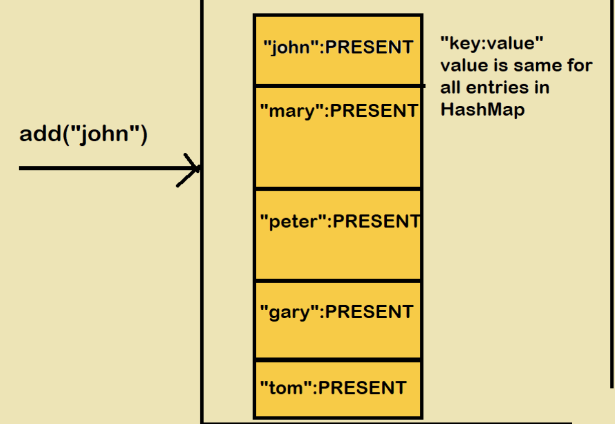

Slide 56
List vs Set
List | Set
The List is an indexed sequence. | The Set is an non-indexed sequence.
List allows duplicate elements | Set doesn’t allow duplicate elements.
Elements by their position can be accessed. | Position access to elements is not allowed.
Multiple null elements can be stored. | Null element can store only once.
List implementations are ArrayList, LinkedList, Vector, Stack | Set implementations are HashSet, LinkedHashSet.

Slide 57
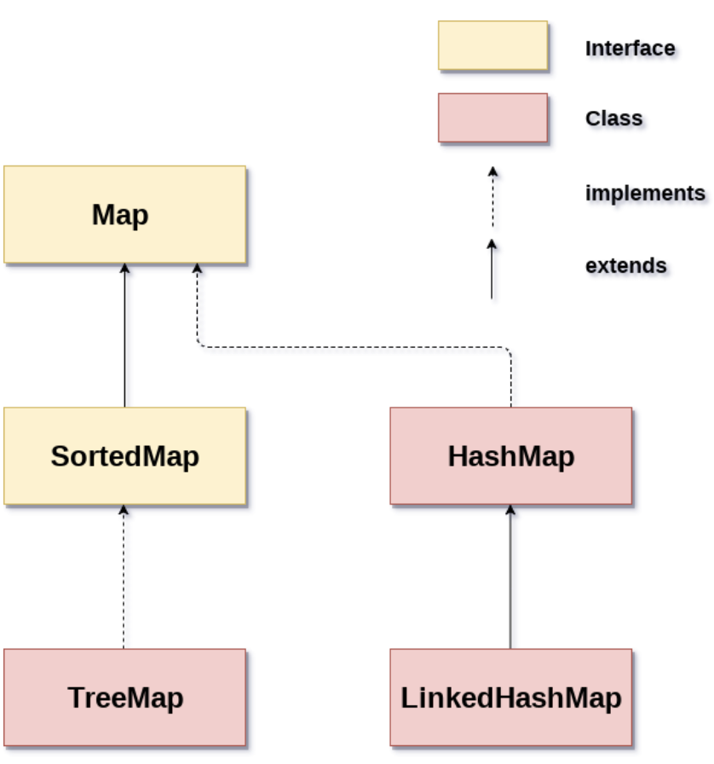
Map - Java
Map contains the value in the basis of key.
i.e key and value pair. Each key and value
known as entry.
Map don’t allow duplicate keys, but can have
duplicate values.
Map is mainly used If you have search, update
or delete element on the basis of keys.

Slide 58
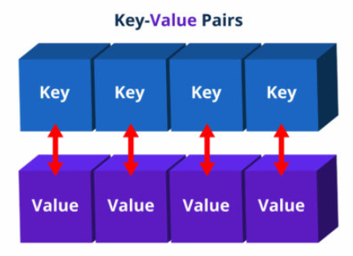
HashMap - Java
HashMap is the implementation of Map, but it doesn’t maintain any order.
LinkedHashMap allows one null key and
mutiple null values.
Disadvantage:
It doesn’t maintain the insertion order.

Slide 59
LinkedHashMap - Java
LinkedHashMap is the implementation of Map. It Inherits HashMap class.
LinkedHashMap maintains the insertion order.
LinkedHashMap allows null keys and values.

Slide 60
TreeMap - Java
TreeMap is the implementation of Map and SortedMap.
It maintains ascending order.
TreeMap doesn’t allow any null key.

Slide 61
Mutable vs Immutable
Difference between mutable and immutable.
Mutable:
Fields can be changed after object creation.
It allows the modification, using an inbuild methods.
It will have both get and set methods
Eg. StringBuilder, StringBuffer, java.util.Date
Immutable:
Fields cannot be changed after the object creation.
Not allow to modify.
It will have only get methods
Eg. String, int, final, private.

